Slide 1
Aristotle University of Thessaloniki
PRESSURES ON WATER RESOURCES-WATER CONSERVATION AND REMEDIATION TECHNIQUES

Slide 2
The Importance of Water
All living things need water
Composes majority of the body of organisms
Habitat for many organisms
Helps regulate climate
Shapes earth’s surface
Dilutes & degrades wastes
Is essential for maintaining an adequate food supply

Slide 3
What are the water resources?
Water resources are sources of water that are useful or potentially useful to humans.
Water is essential for maintaining an adequate food supply and a productive environment for the human population and for other animals, plants, and microbes worldwide.
The main uses of water include agricultural, industrial, household, recreational and environmental activities, all of which require fresh water.
Only 2.5% of the water on the Earth is fresh water, 2/3 of which is frozen in glaciers and polar ice caps (see water proportions on earth in the next slide)
David Pimentel, Bonnie Berger, David Filiberto, Michelle Newton, Benjamin Wolfe, Elizabeth Karabinakis, Steven Clark, Elaine Poon, Elizabeth Abbett, Sudha Nandagopal. Water Resources: Agricultural and Environmental Issues. BioScience (2004) 54 (10): 909-918.

Slide 4
What are the water resources?
Water demand already exceeds supply in many parts of the world. In the near future, problems for covering these demands will certainly occur.
The largest water consumption world wide (almost 70%) regards the irrigation of cultivated lands.
Among other factors, climate change will have significant impact on water resources, since it regulates the hydrologic cycle.
Due to the expanding human population and the increasing demands, competition for water is growing causing the depletion of the worlds’ major aquifers.
Many pollutants threaten water supplies, with the most widespread, especially in underdeveloped countries, being the discharge of raw sewage into natural waters.
David Pimentel, Bonnie Berger, David Filiberto, Michelle Newton, Benjamin Wolfe, Elizabeth Karabinakis, Steven Clark, Elaine Poon, Elizabeth Abbett, Sudha Nandagopal. Water Resources: Agricultural and Environmental Issues. BioScience (2004) 54 (10): 909-918.

Slide 5
Water resources current state
According to GWP, today more than 2 billion people are affected by water shortages in over 40 countries. 263 river basins are shared by two or more nations; 2 million tonnes per day of human waste are deposited in water courses. It is further estimated that half the population of the developing world are exposed to polluted sources of water that increase disease incidence. 90% of natural disasters in the 1990s were water related. The increase in numbers of people from 6 billion to 9 billion will be the main driver of water resources management for the next 50 years.
During the latter half of this century, the pressure on natural water resources in many regions of the world has been increasing dramatically. Currently humans are extracting about half the 12,500 cubic kilometres of water that are readily available. Demand is now growing at twice the rate of population increase and accelerating. This can be attributed to the rapid growth in urban sprawl, the increased pace of industrialization, agriculture and irrigation development and pollution. It is adverted that in 1995 0water availability was estimated to be 7,500 cubic meters per person per year, compared to 12,900 cubic meters in 1970.
IUCN and PBWB (2011). Module 2: Integrated Water Resources Management. Gland, Switzerland: IUCN and Moshi, Tanzania: PBWB . viii + 96 pp.

Slide 6
Water resources current state
Agriculture alone accounts for 70% of all water withdrawn. Best estimates of future global agricultural water consumption (including both rainfed and irrigated agriculture), are of an increase of about 19% by 2050. Much of the increase in irrigation will be in regions already suffering from scarcity of water. Responsible agricultural water management will make a major contribution to future global water security.
Nearly 1 billion people still do not have access to improved sources of drinking water and there are more people without access to tap water in cities today than there were at the end of the 1990s. In addition, 1.4 billion people do not have electricity in their homes, and nearly 1 billion suffer from malnutrition.
South Asia and Southern Africa are predicted to be the most vulnerable regions to climate change related food shortages by 2030. Water stress is also expected to increase in central and southern Europe and by the 2070s, the number of people affected will rise from 28 million to 44 million.
Source:http://www.unesco.org/fileadmin/MULTIMEDIA/HQ/SC/pdf/WWDR4%20Background%20Briefing%20Note_ENG.pdf

Slide 8
Many countries in the Middle East, which has one of the world’s highest population growth rates, face water shortages.
Most water in this dry region comes from the Nile, Jordan or Tigris rivers.

Slide 9
Pressures on water resources
Climate change causes increase in frequencies of droughts and floods
Uneven distribution of rainfalls
Depletion of aquifers caused by over-consumption as a result of population growth
Deforestation
Expansion of irrigated lands
Pollution and contamination by sewage, agricultural and industrial runoff
Irrational management practises

Slide 10
Impacts from pressures on water resources
Degradation of the water resources quality
Negative hydrological balances that cause water reserves shortages
Salinization of aquifers from seawater intrusion due to pumping
Wetlands dry up and ecosystems are damaged
Land subsidence
Change in surface runoff. Development has reduced the permeable soil area and has incresed surface runoff (the most important non-point pollution source)

Slide 11
Solutions to address the impacts
Exploitation of surface water that is wasted. This can be achieved by constructing dams or by implementing artificial recharge
Reduction of water consumption (e.g. change of irrigation methods or cultivation types)
Use of treated waste water
Desalinization of seawater
Education of the populations to modify habits
Water-saving appliances
Repair of infrastructures in order to reduce losses
Updated hydrogeological reports available for the decision makers and stakeholders
Modelling for prediction under different scenarios

Slide 12
Pollution sources
Pollution is the introduction of certain pollutant(s) into the groundwater that reduces its quality, making its use very limited, or in some cases impossible. The main causes of groundwater pollution are usually the many chemicals and various synthetic products we use today
Groundwater contaminants come from two categories of sources: point sources or non-point sources. Landfills, leaking gasoline storage tanks, leaking septic tanks, and accidental spills are examples of point sources. Infiltration from farm land treated with pesticides and fertilizers is an example of a non-point source.
Source: http://pollutionarticles.blogspot.gr/2009/11/groundwater-pollution-definition-and.html
https://www.ec.gc.ca/eau-ater/default.asp?lang=En&n=6A7FB7B21#Sec2https://www.slideshare.net/rajendranjr/water-pollution-47779917

Slide 13
Pollution sources
Point sources
On-site septic systems
Leaky tanks or pipelines containing petroleum products
Leaks or spills of industrial chemicals at manufacturing facilities
Underground injection wells (industrial waste)
Municipal landfills
Livestock wastes
Leaky sewer lines
Chemicals used at wood preservation facilities
Mill tailings in mining areas
Fly ash from coal-fired power plants
Sludge disposal areas at petroleum refineries
Land spreading of sewage or sewage sludge
Graveyards
Road salt storage areas
Wells for disposal of liquid wastes
Runoff of salt and other chemicals from roads and highways
Spills related to highway or railway accidents
Coal tar at old coal gasification sites
Asphalt production and equipment cleaning sites
Source: https://www.ec.gc.ca/eau-water/default.asp?lang=En&n=6A7FB7B2-1

Slide 14
Pollution sources
Non-point (distributed) sources
Fertilizers on agricultural land
Pesticides on agricultural land and forests
Contaminants in rain, snow, and dry atmospheric fallout
Source: https://www.ec.gc.ca/eau-water/default.asp?lang=En&n=6A7FB7B2-1

Slide 15
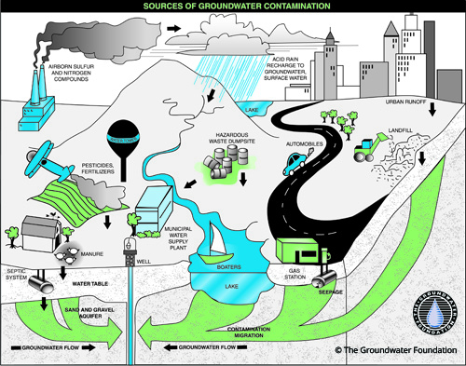
Source: http://www.groundwater.org/get-informed/groundwater/contamination.html

Slide 16
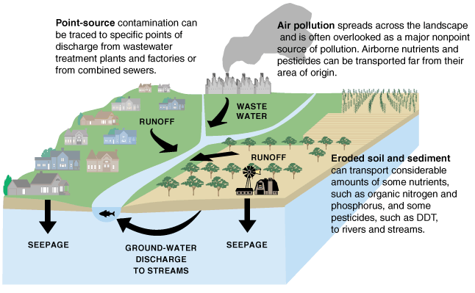
Sources of some water pollutants and movement of pollutants into different water reservoirs of the water cycle
Source: U.S. Geological Survey

Slide 17
Source: https://www.slideshare.net/rajendranjr/water-pollution-47779917

Slide 18
Source: https://www.slideshare.net/rajendranjr/water-pollution-47779917

Slide 19
Surface water pollution sources
The major sources of surface water pollution are:
Sewage: emptying sewers and drains
Industrial effluents
Synthetic detergents: in washing and cleaning
Agrochemicals: fertilizers, inecticides
Oil spill in sea water
Waste heat from industrial discharge
Source: https://www.slideshare.net/rajendranjr/water-pollution-47779917

Slide 20
Controlling Water Pollution
1. Source Reduction (Pollution Prevention)
Cheapest and most effective way to reduce pollution is to avoid producing it or releasing it into the environment.
Design products that do not pollute
Soil Conservation
2.Ban release of pollutants
3.Reward purchasing environmentally preferable products (e.g. rebates)

Slide 21
Remediation techniques
Remediation is the return of an area or component to as natural a condition as possible (e.g., contaminated water).
There are three main types of remediation methods:
Physical treatment may include air striping, filtering of water, etc.
Chemical treatments include addition of chemicals that facilitate physical or biological treatments, or oxidize contaminants, etc.
Biological treatment (bioremediation) utilizes complex biochemical pathways f various organisms to degrade or detoxify contaminants
According to the type of the contaminant, the most appropriate technique of remediation should be selected. The following techniques are the most common:
Pure compound recovery is applicable when the contaminant is not soluble in the water
Pump and treat methods include pumping of the contaminated water and treatment
In situ remediation techniques that does not involve removal of the water or the soil
Description of some of the most common applied remediation techniques are presented in the following slides

Slide 22
Remediation techniques
Pump and treat method
Conventional pump-and-treat methods involve pumping of contaminated water to the surface for treatment.
Pump-and-treat systems are used primarily to accomplish the following:
• Hydraulic containment. To control the movement of contaminated ground water,
preventing the continued expansion of the contaminated zone. The figure on the following slide illustrates three major configurations for accomplishing hydraulic containment: (1) a pumping well alone, (2) a subsurface drain combined with a pump well, and (3) a well within a barrier wall system.
• Treatment. To reduce the dissolved contaminant concentrations in ground water suffiAlthough hydraulic containment and cleanup can represent separate goals, more typically, remediation efforts are undertaken to achieve a combination of both. For example, if restoration is not feasible, the primary objective might be containment. In contrast, where a contaminated well is used for drinking water but the contaminant
source has not been identified, treatment at the wellhead might allow continued use of the water even though the aquifer remains contaminated
Source: http://www.qedenv.com/files/Introduction%20to%20Pump%20&%20Treat%20Remediation.pdf
Pump-and-Treat Ground-Water Remediation A Guide for Decision Makers and Practitioners. United States
Environmental Protection Agency, Office of Research and Development Washington, DC 20460EPA/625/R-95/005, July 1996

Slide 24
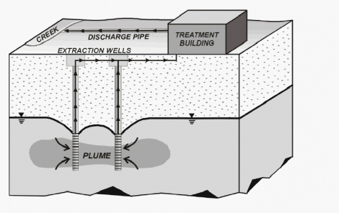
Remediation techniques
Pump and treat method
A pump and treat operation consists of several wells that extract contaminated water from the subsurface, and a treatment plant either on or off-site that returns the water to an acceptable quality standard. Once treated, the water can be released into a surface water body or injected back underground.
Source: https://mostlyharmlessscience.com/2014/01/26/mom-how-do-i-clean-up-the-mess/

Slide 25
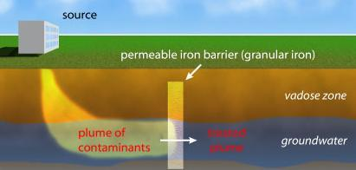
Remediation techniques
Permeable reactive barrier
A permeable reactive barrier is essentially a curtain that is placed across the flow path of the contaminated groundwater. The curtain reacts with the contaminant, either immobilizing it or converting it into a non-toxic form. The ‘active ingredient’ commonly used in these barriers is zerovalent iron, which reacts with just about anything it happens to find. Since installation of such a barrier requires excavation and construction, the direction and speed of groundwater flow must first be known with certainty.
Source: https://mostlyharmlessscience.com/2014/01/26/mom-how-do-i-clean-up-the-mess/

Slide 26
Remediation techniques
Air stripping
Air stripping is the process of moving air through contaminated groundwater or surface water in an above-ground treatment system. Air stripping removes chemicals called “volatile organic compounds” or “VOCs.”
Air is injected into a double screened well, lifting the water in the well and forcing it out the upper screen.
Simultaneously, additional water is drawn in the lower screen.
Once in the well, some of the VOCs in the contaminated ground water are transferred from the dissolved phase to the vapor phase by air bubbles.
The contaminated air rises in the well to the water surface where vapors are drawn off and treated by a soil vapor extraction system.
Source: https://clu-in.org/download/Citizens/a_citizens_guide_to_air_stripping.pdf
http://www.responsiblebusiness.eu/display/rebwp8/In-Well+Air+Stripping

Slide 27
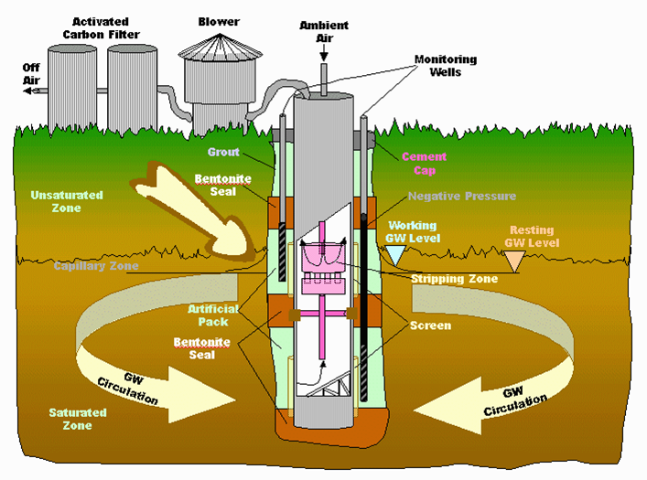
Remediation techniques
Air stripping
Typical UVB Vacuum Vapor Extraction Diagram
Source: http://www.responsiblebusiness.eu/display/rebwp8/In-Well+Air+Stripping

Slide 28
Remediation techniques
Air sparging
Air sparging (AS) is the process of injecting air directly into groundwater. Air sparging remediates groundwater by volatilizing contaminants and enhancing biodegradation. It is akin to blowing bubbles from a straw into a bowl of water. As the bubbles rise, the contaminants are removed from the groundwater by physical contact with the air (i.e., stripping) and are carried up into the unsaturated zone (i.e., soil). As the contaminants move into the soil, a soil vapor extraction (SVE) system is usually used to remove vapors. The addition of oxygen to contaminated groundwater and soils also enhances biodegradation of contaminants in and above the water table, as it acts as a nutrient for bacteria. There are several enhancements to air sparging. The target contaminant groups for air sparging are VOCs and fuels in groundwater.
Source: http://www.cpeo.org/techtree/ttdescript/airspa.htm

Slide 29
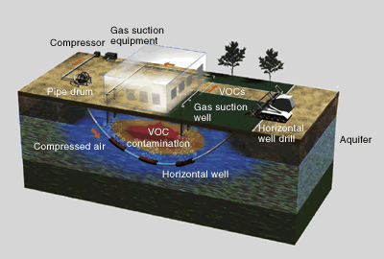
Remediation techniques
Air sparging
Source: http://employees.oneonta.edu/vislovt/mgp/excavation/air%20sparging.htm

Slide 30
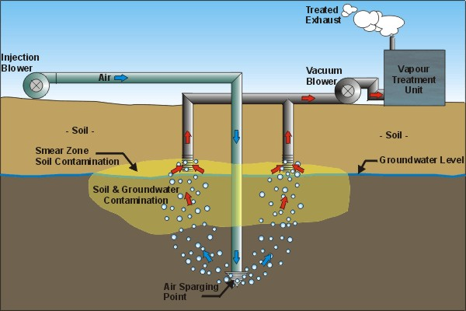
Remediation techniques
Air sparging
Air is bubbled under pressure, and the bubbles search ways to rise in the aquifer. The tighter the aquifer (for example, clay), the harder it is for the bubbles to move. Thus, sparging works best with loose aquifers. Various combinations of sand, gravel, silt, and clay make for loose aquifers. Solid layers of clay and silt make aquifers tight.
Source: http://www.amiadini.com/NewsletterArchive/130204-NL202/envEnl-202.html

Slide 31
Remediation techniques
Groundwater bioremediation
In situ bioremediation (ISB) of groundwater involves the encouragement of indigenous
Bacterial populations to metabolize target contaminants through the addition of various amendments (biostimulation) to the subsurface environment. In addition to amendments, select strains of bacteria may be added to the subsurface to help treat some sites (bioaugmentation). Bacteria perform coupled oxidation/reduction (redox) reactions to live, and bioremediation exploits these reactions to remove contaminants from contaminated
media (soil, air, or groundwater).
Source: https://clu-in.org/download/remed/introductiontoinsitubioremediationofgroundwater_dec2013.pdf
Introduction to in situ bioremediation of groundwater, Office of Solid waste and Emergency Response, EPA-542-R-13-018, December 2013

Slide 32
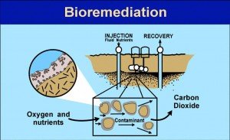
Remediation techniques
Groundwater bioremediation
Source: https://followgreenliving.com/cleaning-planet-bioremediation/

Slide 33
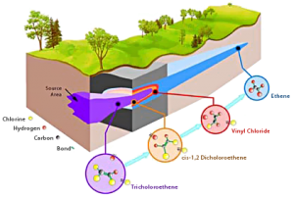
Remediation techniques
Groundwater bioremediation
In situ bioremediation
Source: https://followgreenliving.com/cleaning-planet-bioremediation/

Slide 34
Remediation techniques
Electrokinetic extraction
Groundwater can get contaminated with heavy metals from land fill leachate, sewage, leachate from mine tailings, deep-well disposal of liquid wastes, seepage from industrial waste lagoons or from industrial spills and leaks.
When a direct current electrical field is applied across a wet mass of contaminated soil, the migration of non-ionic pore fluids by electro-osmosis and the ionic migration of dissolved ions towards the electrodes take place. Combining these two removal mechanisms result in the electrokinetic extraction of metal contaminants from soils (Lestan, 2008)
Source: Lestan, D., Luo, C.-l., Li, X.-d., 2008. The use of chelating agents in the remediation of metal-contaminated soils: a review. Environmental Pollution 153, 3 -13.
Evanko, C.R., Dzombak, D.A., 1997. Remediation of Metals-contaminated Soils and Groundwater, Technology Evaluation Report, TE-97-01. Ground-Water Remediation Technologies Analysis Center, Pittsburg, PA.
M.A. Hashim, Soumyadeep Mukhopadhyay, Jaya Narayan Sahu, Bhaskar Sengupta.Remediation technologies for heavy metal contaminated groundwater. Journal of Environmental management, 92 (2011)2355-2388

Slide 35
Remediation techniques
Electrokinetic extraction

Slide 36
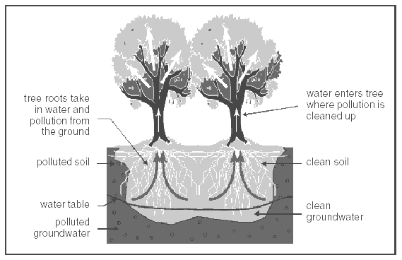
Remediation techniques
Phytoremediation
Phytoremediation is a bioremediation process that uses various types of plants to remove, transfer, stabilize, and/or destroy contaminants in the soil and groundwater.
Source: https://senthilarivan.wordpress.com/page/2/

Slide 37
Dams
Dams are artificial constructions for the exploitation of the surface water. They are barriers.
A dam is a barrier built across a stream or river to stop or control the flow of water.
Dams store water for many different purposes: irrigation, drinking water, generate electricity, and for recreation. Small dams are usually built in order to control flooding.
Over 48,000 large dams are in operation worldwide.
The majority of the dams built in the world are single-purpose dams, but the last decades the trend worldwide is to construct multipurpose dams. The irrigation is by far the most common purpose of dams. Among the single purpose dams, 48 % are for irrigation, 17% for hydropower (production of electricity), 13% for water supply , 10% for flood control, 5% for recreation and less than 1% for navigation and fish farming.
Source: http://www.icold-cigb.org/GB/dams/role_of_dams.asp
https://www.internationalrivers.org/dams-what-they-are-and-what-they-do
http://wwf.panda.org/what_we_do/footprint/water/dams_initiative/

Slide 38
Dams
Demand for water is steadily increasing throughout the world. There is no life on earth without water, our most important resource apart from air and land. During the past three centuries, the amount of water withdrawn from freshwater resources has increased by a factor of 35, world population by a factor of 8. With the present world population of 5.6 billion still growing at a rate of about 90 million per year, and with their legitimate expectations of higher standards of living, global water demand is expected to rise by a further 2-3 percent annually in the decades ahead.
Source: http://www.icold-cigb.org/GB/dams/role_of_dams.asp

Slide 39
Dams
In order to select the most appropriate location for the construction of a dam the morphological, hydrological, hydrogeological conditions are examined in three scales:
Drainage basin scale
Dam reservoir scale
Construction zone of the dam
In the following slides the basic parameters that are examined are presented

Slide 40
Dams
Drainage basin scale
Geomorphological parameters
The area and the shape of the basin are examined. The area determines the amount of the discharge. The shape determines the concentration time and therefore the maximum flood discharge. Other parameters that are calculated are the hypsometric curve, the mean altitude, the mean slope, the relief ratio etc
Hydrographic network parameters
The main parameters that regard the characteristics of the hydrographic network such as the drainage frequency, the drainage density, the bifurcation ratio etc are caclculated
The existence of springs is recorded. A water table map is designed. The investigation of the permeability of the geological formations is of major importance.
A detailed and reliable hydrological budget is estimated .
The vegetation ,cultivated land, population, water demands and economic activities that take place within the basin area area analyzed.
The total amount of transported sediments from the river is estimated.

Slide 41
Dams
Dam reservoir
Geomorphological parameters are examined.
The ideal reservoir is the one that has large capacity and small depth. At this stage of investigation the (dam) height-reservoir capacity plot is drawn.
Mapping of the area
The geological formations are mapped in a scale 1:1000. Geological sections are constructed.
Hydrogeological regime
Based on the water table map, the groundwater flow is examined in order to secure that there will be no losses from the reservoir. The permeability of the formations is examined from samples taken from boreholes drilled in the reservoir area.

Slide 42
Dams
Construction zone of the dam
Geomorphological parameters
A determining parameter in order to select the most appropriate location for the dam construction is the cross-sectional area. The ratio of the dam (reservoir) capacity divided by the cross-sectional area is used as a suitability criterion
Mapping of the area
The area is mapped in scale 1:100. The stability, strength and permeability of the formations is investigated

Slide 43
Dams
Main environmental impacts caused by the dams are the following:
Impacts on flora and fauna
Change in micro-climate of the area
Interruption of the aquifers recharge downstream of the dam
The water after passing through a dam has erosional activity and not depositional
Interruption of the recharge of deltaic areas in water and sediments at the estuaries of the rivers
Change of the basic level of the area, alterating the erosion-deposition regime of the streams and rivers in the area
Possible results of the alteration of the environment that the dam will cause is the manifestation of springs or landslides. A land use change from the inhabitants might be required in the broader dam area

Slide 44
Surface reservoirs
Surface reservoirs are constructed outside the riverbed.
The selcted area for the construction must fulfill the following criteria:
to be horizontal
the geological formations should be impervious (k<10⁻⁷m/s)
to be located close to the river
to be in a lower elevation from the river abstraction point in order to flow under gravity without energy cost
Reservoirs are constructed with clay material
. Advantages of reservoirs compared to dams:
-it is easier to detect a geological suitable location
The construction cost is significantly lower
-they are environmentaly acceptable
The disadvantages are:
they have relatively small capacity
the large amount of evapotranspiration due to the small water depth
Only a small percentage of the river discharge is exploitated
The cost of the channel for the transfer of the water might be high, especially if pumping is required

Slide 45
Groundwater modelling
What is the purpose for the implementation of modelling?
Simulation of the procedures that control the function and development of an aquifer.
Study and planning of alternative groundwater resources management actions.
Project planning and implementation of the appropriate measures according to the best scenario for the water resources usage optimization.

Slide 46
Groundwater modelling
Mathematical models simulate the groundwater flow using differential equations that solve equations that describe the groundwater flow (Darcy, Boussinesq, Laplace, Bernoulli, continuity equation, diffusion and heat transfer) using analytical or numerical methods.
α. Analytical methods.
They are precise and no errors are involved. They approximate quite well hydraulic parameters values (e.g. transmissivity). The structure complexity of the aquifers sometimes makes analytical methods solution not possible or deteriorates the implementation in simple cases.
β. Numerical methods.
Numerical methods are applied when solution with analytical methods is not possible. The calculation of the unknown parameter (load) takes place in nodes spatially and versus time. For the groundwater flow the most common methods are, finite differences, finite elements, boundary elements and moving averages.

Slide 47
Mathematical model construction:
According to Anderson & Woessner (1992), for the construction of groundwater flow model the following stages are necessary:
Objective of the model (determination of the problems that the model is going to solve).
Collection of the geological, hydrogeological data for the designing of the conceptual model. The conceptual model is consisting of assumptions that simplify the problem.
Selection of the appropriate code (MODFLOW, PTC) that can accomplish the target and will be compatible to the available data.
Model design. The grid, initial and boundary conditions are chosen.
Calibration. Many “runs” are executed and the parameters are adjusted in order to determine if the model results represent /reproduce the measured (fileld) data. The “trial and error” technique is applied.
Sensitivity analysis. In order to increase the reliability of the calibrated model , the effects of the input parameter changes on the model results is examined.
Verification. If a second data set is available a second calibration takes place. If the calibrated model is verified the credibility level is increased.
The verified and calibrated model can be used for prediction. If a calibrated but not verified model is used for prediction the reliability level is very low.
Prediction sensitivity analysis . Given that there is uncertainty even for a calibrated and verified model prediction sensitivity analysis is performed.
The user is ready to present the model results

Slide 48
Groundwater modelling
Basic principals regulating the code:
-The aquifer can be simulated for steady state and transient state.
-The mathematical background is based on finite differences for the center of each cell.
-There is no flow outside the model boundaries.
-The porous media must be homogeneous.
-The porous media can be anisotropic
-The groundwater flow system can be a combination of unconfined, semi-confined and confined aquifers. The upper layer is usually considered to be unconfined.
-Flow can be simulated in 3D.

Slide 49
Groundwater modelling
MODFLOW is the most common code used for groundwater modelling worldwide

Slide 50
Groundwater modelling
Some assumptions of the MODFLOW code are shown below:
-The water density is considered steady.
-The flow takes place in three dimensions( x,y,z).
-Each cell properties are distributed uniformaly and homogeneously.

Slide 51
Data required for the ΜODFLOW implementation:
Geometrical characteristics of the aquifer
Initial heads i.e. The initial groundwater level to all the nodes of the grid
Boundary conditions
Aquifer’s depth
Hydraulic parameters (Hydraulic conductivity, transmissivity, storage coefficient )
Pumping or recharge yields
Infiltration data
River percolation
Irrigation return

Slide 52
The most common boundary conditions of groundwater are:
Groundwater modelling
Dirichlet condition. This kind of boundary condition appears when we have constant head (e.g. Lake or sea)
Neuman condition (or condition of steady flow)
Cauchy condition. The flow rate depends on the head

Slide 53
Groundwater flow mathematical models, take place in two stages:
Steady state (does not take into account time)
Transient case

Slide 54
Groundwater modelling
Cell types according to their prevailing properties that MODFLOW code uses:
-Constant-head, where the water level is determined in advance and keeps this value for a stress period, but the amount of water that enters or exit the cell varies in relation to the head changes of the neighboring cells
-Transient-head, where head is changing during time. This general condition characterizes all the cells for which no boundary condition has been determined and the code calculates through the solution of the equations a head for each cell and stress period.

Slide 55
Groundwater modelling
General head boundaries, these are cells where the flowrate depends on a steady visual head and changes in every stress period. The visual head it is considered to be so far from the model area that does not affect the models heads.
-No flow or inactive, where no flow between the cells and the outside space takes place.
-Steady flowrate, where the flow between the cell and the outside space reserves steady for a stress period.
The number of cells that can be used is unlimited and depends on the computer capabilities.

Slide 56
Groundwater modelling
For the calibration of a model the most usual convergence criteria are the groundwater tablde level and the hydrological balance

Slide 57
Seawater intrusion
Seawater intrusion is the movement of seawater into fresh water aquifers due to natural processes or human activities. Seawater intrusion is caused by decreases in groundwater levels or by rises in seawater levels. Seawater intrusion occurs in coastal freshwater aquifers.
The reasons that can cause seawater intrusion are:
The overpumping of the aquifers. That means that the groundwater withdraw exceeds the recharge rate. Overpumping is by far the most important factor that cause seawater intrusion
Reduction of the rivers discharge at the estuaries
Artificial channel construction
Climate change
Interventions at the rivers flow regime
Tide
Source: http://www.lenntech.com/groundwater/seawater-intrusions.htm

Slide 58
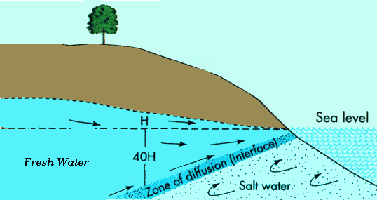
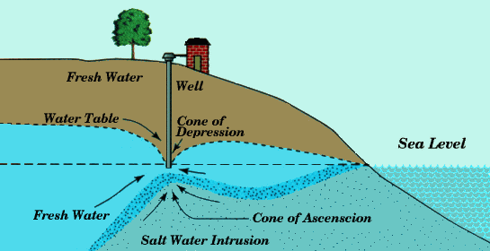
Seawater intrusion
The figure depicts the relation of fresh and sea water in a coastal aquifer.
The depth of the diffusion zone at a specific location is given by the Ghyben-Herzberg equation:
Z=40 H
Z= depth beneath sea level
H= groundwater level above sea level
The seawater intrusion due to pumping is depicted
Source: http://www.lenntech.com/groundwater/seawater-intrusions.htm

Slide 59
Seawater intrusion
Environmental impacts to the aquifers from the seawater intrusion:
aquifers are constituted unsuitable for drinking purposes
the increased salinity makes water inapropriate for irrigation
The seawater intrusion is one of the most important problems that the governments of coastal countries (especially mediterranean) have to face. The increasing population, the increased demand during the summer months due to tourism and agricultural activities have intensified the problem the last decades.
Four main steps must be followed in order to solve this problem.
Measurements: it is a necessary action for the estimation of the current state and the delineation of the problem
Monitoring: the development of an appropriate network of wells for the monitoring of the changes over time and space must be designed
Modelling: the researchers should select an appropriate software for the simulation of the present conditions and for prediction under different fututre scenarios
Responce: the decision makers must take measures according to the results of the prediction scenarios

Slide 60
Seawater intrusion
Indicative computational codes regarding the seawater intrusion:
SUTRA
HST3D: 3D
SWICHA
METROPOL
SWIFT
FAST
FEFLOW
D3F
SEAWAT

Slide 61
Seawater intrusion
Main technics applied to prevent seawater intrusion:
Barriers
Artificial recharge
Pumping control
Relocation and redesign of wells
Modification of pumping patterns
Prevention of surface seawater intrusion from channels
Exploitation of available surface water and reduction of groundwater withdrawal
Desalinisation Techniques
The selection of the appropriate method is based on:
The size of the intrusion
The origin of salt water
The hydrogeological conditions of the ara (type of aquifers etc)
The water use
Financial criteria

Slide 62
Seawater intrusion
Barriers to control seawater intrusion:
Pumping trough barriers
Injection barriers
Subsurface impermeable barriers
Biological barriers

Slide 63
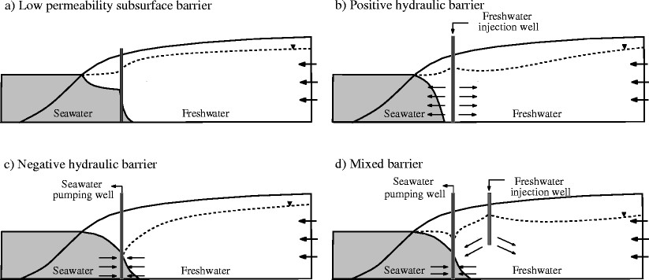
Seawater intrusion
Types of barriers to control seawater intrusion
Source: Dynamics of negative hydraulic barriers to prevent seawater intrusion - Scientific Figure on ResearchGate. Available from: https://www.researchgate.net/227050962_fig1_Figure-1-Types-of-barriers-to-control-seawater-intrusion-a-low-permeability-subsurface [accessed 19 Mar, 2017]

Slide 64
Artificial recharge
Artificial recharge of groundwater is the process of increasing the water amount that enters an aquifer through human effort. Many different techniques and purposes exist for causing artificial recharge. The water surplus of an area (mainly from surface water) is stored in the aquifers for later use.
Artificial recharge may be carried out for various purposes:
To prevent land subsidence caused by the groundwater drawdown due to overpumping, reducing the risk of damage to nearby structures.
To avoid depletion of water resources when dewatering is carried out in aquifers used for water supply.
To reduce environmental impacts on sensitive water-dependent features such as wetlands.
To conserve the excess of surface water that would be wasted for future requirements
To improve the quality of groundwater (through dilution) i areas that the problem is qualitative and not quantitative
To prevent seawater intrusion
To control flooding
Source: https://www.slideshare.net/sainiankit003/artificial-ground-water-recharge
http://www.waterencyclopedia.com/A-Bi/Artificial-Recharge.html

Slide 65
Artificial recharge
Why do we implement artificial recharge?
The rainfall distribution in a country varies from one region to another. Therefore the availability of the surface water in some areas is low. The temporal distribution of the rainfall in the year is also a restricting factor for the use of surface water, since during the summer period that the water demands are high, the surface water is at the lowest level.
Advantages of artificial recharge:
The losses from evapotraspiration are negligible
The stored water is relatively protected from natural hazzards (e.g. Landslide) and pollution

Slide 66
Artificial recharge
Artificial recharge is implemented in areas where:
a continuous water level drawdown is recorded
The discharge in wells or springs is inadequate especially during the dry months
The quality is poor and groundwater is the only available resource
It is very important to ensure that the water that will be used for artificial recharge is of good quality. In any other case it should not be used because the risk to pollute the aquifers is extremely high. Otherwise the water should be appropriate treated. In some cases waste water is used for recharge after treatment.

Slide 67
Artificial recharge
Prerequisites for artificial recharge:
The existence of surface water surplus
The quality of the water to be good and chemical compatible with the existing water in the aquifers
The geological-hydrogeological conditions must be appropriate (e.g. the permeability of the aquifers must high, there must be a hydraulic connection between the aquifers e.t.c.)
The cost for the construction and maintrenance of the infrastructures must be viable.

Slide 68
Artificial recharge techniques
a. Direct surface techniques
•Flooding
•Basins or percolation tanks
•Stream augmentation
•Ditch and furrow system
•Over irrigation
b. Direct sub surface techniques
•Injection wells or recharge wells
•Recharge pits and shafts
•Dug well recharge
•Bore hole flooding
•Natural openings, cavity fillings.
c. Combination surface –sub-surface techniques
•Basin or percolation tanks with pit shaft or wells.
d. Indirect Techniques
•Induced recharge from surface water source.
•Aquifer modification.
These methods are applicable in uncofined aquifers. Large areas are required. The recharge rate depends onthe soil materila properties. The water used must be free from suspended material
In these techniques the recharge is applied directly to the aquifers usually through wells, boreholes e.t.c.
In induced recharge a cone of depression is created after pumping. The surface water replenish the abstracted groundwater causing recharge of te aquifer.
Source: https://www.slideshare.net/sainiankit003/artificial-ground-water-recharge

Slide 69
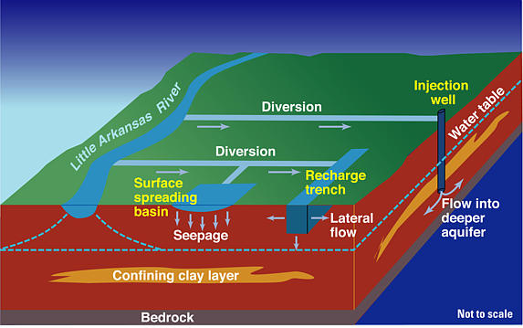
Artificial recharge techniques
Source: https://ks.water.usgs.gov/pubs/reports/wrir.99-4250.html

Slide 70
Artificial recharge techniques
Source: http://www.ecy.wa.gov/programs/wr/asr/images/pdf/rechargegraphic.pdf

Slide 71
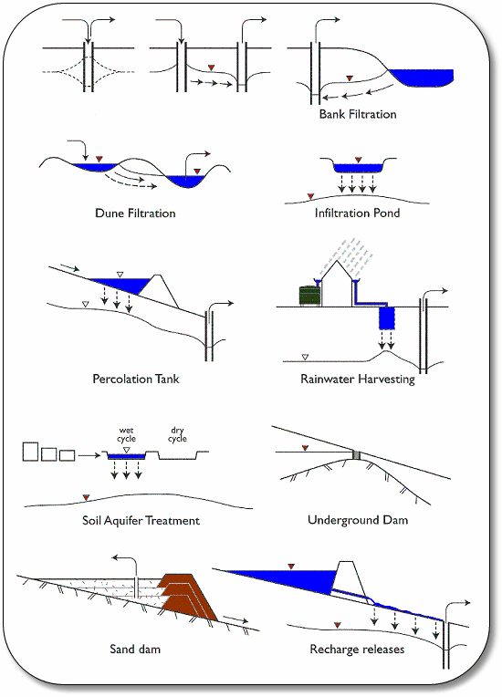
Artificial recharge techniques
Source: http://www.solar.excluss.com/water/boreholes/groundwater-dictionary/index7685.html?artificial_recharge.htm

