Slide 1
Aristotle University of Thessaloniki
Groundwater-aquifers

Slide 2
Approximately 30% of all fresh water on Earth is stored as groundwater. The amount of water held as groundwater is more than 100 times the amount collected in rivers and lakes. The majority of the human demands are covered by the groundwater resources world wide. Exploitation of groundwater in the aquifers takes place via pumping from boreholes and wells
What are the advantages of groundwater compared to the surface water?
Groundwater has:
Better quality
Better protection against pollution
Very low (negligible) evaporation
Surface water freeze up or dry up in some periods.
Exploration of groundwater is low cost
The availability does not depend on the season in the year
Source: Shiklomanov IA Rodda JC . (2003). World Water Resources at the Beginning of the Twenty-first Century. Cambridge (United Kingdom): Cambridge University Press.

Slide 3
Aquifers
Aquifer: An underground layer consisted of water bearing permeable formation (or group of formations) that is sufficient saturated. An aquifer can yield water to wells and springs.
Groundwater: the amount of water in underground formations pores or discontinuities
Water table: the surface of the upper part of the saturated zone
The water of the saturated zone in the aquifers can be found between the pores of the grains of the formations (primary porosity) or between the discontiniutites in hard rocks (secondary porosity). This is the amount of water that we can pump and exploit in order to meet our demands.
In the next slides a description of the vertical distribution of groundwater is given

Slide 4
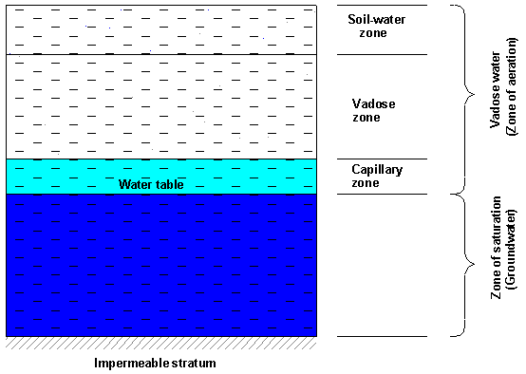
Vertical distribution of groundwater
Source: http://echo2.epfl.ch/VICAIRE/mod_3/chapt_2/main.htm
http://www.indiawaterportal.org/articles/vertical-distribution-groundwater-presentation-acwadam.

Slide 5
Vertical distribution of groundwater
The aeration zone is divided into three sub-zones (Bedient et al, 1994): a) The root zone (soil water zone), which extends from the ground surface down through the major root zone. Its extension varies with the soil type and vegetation. The moisture distribution in this zone is affected by precipitation, irrigation, air temperature and humidity and by the possible presence of a close water table (Bear, 1978). The root zone contains beside the molecular water (the bounded water) capillary water and gravitational water. Hygroscopic water remains adsorbed to the surface of soil grains; capillarity water is suspended in the canals formed by interconnected pores of small diameter, while gravitational water is drained under the influence of gravity through the big pores in communication. While the capillarity water moves in any direction (laterally, upward or downward) depending on the local conditions, the gravitational water moves downward. Temporarily, during excessive precipitation or flooding, the surface layers of the soil may be very close to saturation.
Source: http://echo2.epfl.ch/VICAIRE/mod_3/chapt_2/main.htm
Bedient, P., et al, 1994. Groundwater Contamination. Transport and Remediation. Prentice Hall, New Jersey.

Slide 6
Vertical distribution of groundwater
(b) The capillary zone, or fringe zone, extends from the water table up to the limit of capillary rise. The thickness of capillary fringe depends on the soil's properties and on the homogeneity of the soil, mainly on the pore size distribution. Because of the irregularities in the size of the openings, capillary water does not rise to the same height above the water table; thus, it forms an irregular fringe. The thickness of capillary fringe can range from 2,5 cm for fine gravel to more than 700 cm for silt . In practical applications the upper limit of capillary fringe is considered as a smooth surface, below which the soil is assumed to be almost saturated (Bear, 1978); still the pressure is less than atmospheric. Vertical and horizontal flow of water may take place; the flow in the capillary fringe is neglected when the thickness of the saturated zone is greater than the vertical development of the capillary zone. Within this zone there is a gradual decrease in moisture content with the height above water table, from complete saturation just above the water table to the upper limit when only the smaller connected pores are filled up with water. If the capillary fringe reaches the ground surface, it can provide directly water for evaporation. As water evaporates from the soil surface, it can be replaced by water from the zone of saturation drawn upward by capillarity. The water can also evaporate and move through the air space in the pores as vapors. Still, the amount of vapors water movement in the unsaturated zone is much less important than the transport in the liquid form.
Source: http://echo2.epfl.ch/VICAIRE/mod_3/chapt_2/main.htm
Bear, J., 1978. Hydraulics of groundwater. McGraw-Hill, New York.

Slide 7
Vertical distribution of groundwater
(c) The vadose zone (also called intermediate zone) extends from the lower edge of the root zone to the upper limit of the capillary zone. The thickness of vadose zone depends on the depth of water table below the ground surface, so that it may vary from zero for high water table conditions to hundred of meters in arid regions. In the vadose zone the water is permanently held in place by hygroscopic and capillary forces; these forces cannot retain any surplus of water coming from the root zone, which moves downward (percolation) through the vadose zone as gravitational water.
Source: http://echo2.epfl.ch/VICAIRE/mod_3/chapt_2/main.htm

Slide 8
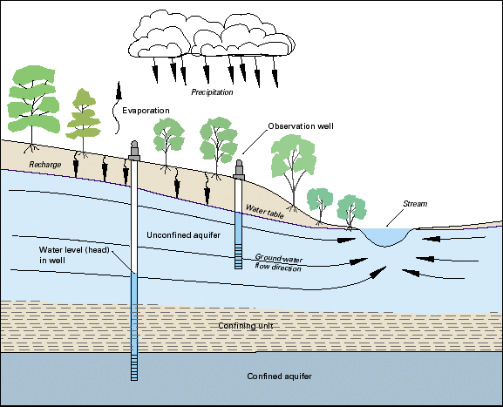
Types of aquifers
Source: https://www.e-education.psu.edu/earth111/node/911

Slide 9
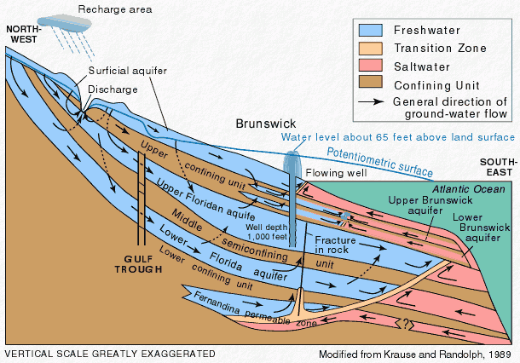
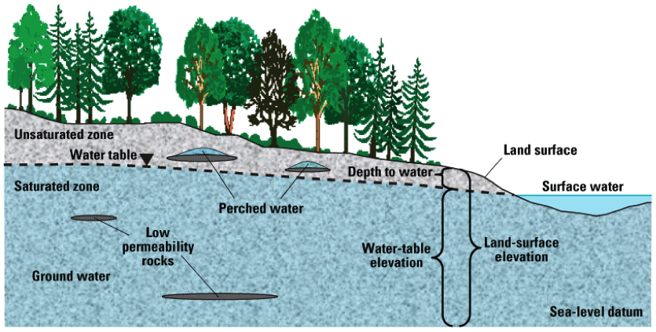
Types of aquifers
Unconfined aquifer: the aquifer formation extends essentially to the land surface. As a result, the aquifer is in pressure communication with the atmosphere. In unconfined aquifers the water table marks the top of the groundwater system (see previous slide).
Confined aquifer: this type of aquifer is isolated from pressure communication with overlying or underlying geologic formations–and with the land surface and atmosphere – by one or more confining layers or confining units. When such aquifers are penetrated by wells, the water rises above the point at which it was first found because a confined aquifer is under pressure exceeding that of atmospheric pressure. (see previous slide)
Perched aquifers: occur above discontinuous aquitards, which allow groundwater to “mound” above them. The dimensions of perched aquifers are typically small and the volume of water they contain is sensitive to climate conditions and therefore highly variable in time.
Artesian aquifer: An artesian aquifer is a confined aquifer containing groundwater under positive pressure. This causes the water level in a well to rise to a point where hydrostatic equilibrium has been reached. Not all the confined aquifers are artesian, because the water table must reach the surface (not the case for underground groundwater such as, for example, the Nubian Sandstone Aquifer System). The recharging of aquifers happens when the water table at its recharge zone is at a higher elevation than the head of the well.
Source: https://www.e-education.psu.edu/earth111/node/911
https://water.usgs.gov/edu/gwartesian.html
https://www.revolvy.com/main/index.php?s=Artesian%20aquifer&item_type=topic

Slide 10
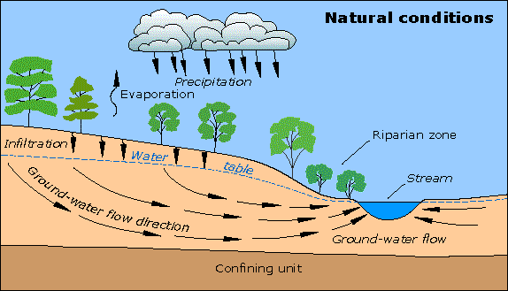
Groundwater flow
The groundwater flows through the pores in a continuous medium or by following prefferntial flowpaths through the fractures in a hard rock.
Source: https://water.usgs.gov/edu/earthgwdecline.html

Slide 11
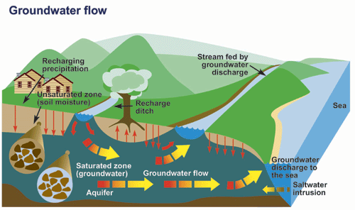
Groundwater flow
Groundwater flow takes place due to the head difference and is dependent on the hydraulic gradient
Source: https://www.ec.gc.ca/eau-water/default.asp?lang=En&n=300688DC-1

Slide 12
Groundwater flow-Hydraulic head
Bernoulli’s Equation
The Bernoulli equation is an expression of the principle of the conservation of energy
Total Hydraulic Head
Considering that the velocity of groundwater flow is very low it comes out as a result that the hydraulic head is the sum of elevation head (z) and pressure head (h_{p})
or
See the figure in the next slide
Where:
h= hydraulic head
P= hydrostatic pressure
γ= specific

Slide 13
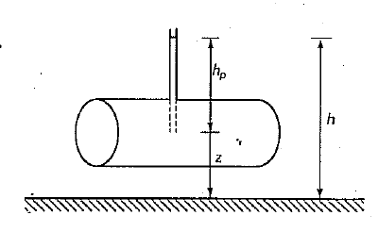
Groundwater flow-Hydraulic head

Slide 14
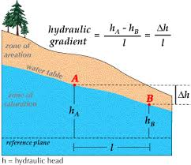
Groundwater flow-Hydraulic gradient
Δh = head loss over a horizontal length, l, in the direction of flow (Δh in m and l in m)
Hydraulic gradient is usually expressed as (% ) or (‰)
Source: https://www.physicsforums.com/threads/confusion-over-hydraulic-gradient-l-parameter.835218/

Slide 15
Groundwater flow-Hydraulic conductivity
The hydraulic conductivity of a soil is a measure of the soil's ability to transmit water when submitted to a hydraulic gradient
The dimension of k is the same as that for velocity, that is, length per unit of time
Hydraulic conductivity is one of the hydraulic properties of the soil; the other involves the soil's fluid retention characteristics. The hydraulic conductivity determines the ability of the soil fluid to flow through the soil matrix system under a specified hydraulic gradient; the soil fluid retention characteristics determine the ability of the soil system to retain the soil fluid under a specified pressure condition
The hydraulic conductivity depends on the soil grain size, the structure of the soil matrix, the type of soil fluid, and the relative amount of soil fluid (saturation) present in the soil matrix. The important properties relevant to the solid matrix of the soil include pore size distribution, pore shape, tortuosity, specific surface, and porosity. In relation to the soil fluid, the important properties include fluid density, , and fluid viscosity.
The hydraulic conductivity of a porous media is equal to 1, when it transmits in the unit of time vertical to the direction of the water flow , the unit of volume through a unit surface having hydraulic gradient equal to 1 under the prevelance of the kinematic viscosity
Source: http://web.ead.anl.gov/resrad/datacoll/conuct.htm

Slide 16
Hydraulic conductivity-Typical values of soil and rock materials
Source: http://www.aqtesolv.com/aquifer-tests/aquifer_properties.htm
Domenico, P.A. and F.W. Schwartz, 1990. Physical and Chemical Hydrogeology, John Wiley & Sons, New York, 824 p.

Slide 17
Hydraulic conductivity-Typical values of soil and rock materials
Hydraulic conductivity is characterized as:
Very high when k≥10⁻² (m/sec)
high when 10⁻⁵<k<10⁻² (m/sec)
average when 10⁻⁸<k<10⁻⁵ (m/sec)
small when 10⁻¹⁰<k<10⁻⁸ (m/sec)
Very small when k≤10⁻¹⁰ (m/sec)
Depending on the hydraulic conductivity geologiacal formations are classified as:
High permeable when k≥10⁻¹ (m/sec)
permeable when 10⁻⁶<k<10⁻¹ (m/sec)
Low permeable when 10⁻⁶>k>10⁻⁹ (m/sec)
impermeable when k≤10⁻⁹ (m/sec
Source: Morris D.A., Johnson A (1967): “Summary of hydrologic and physical properties of rock and soil materials as analyzed by the Hydrologic Laboratory of the U.S. Geological Survey 1948-1960, U.S. Gological Survey Water-Supply Paper 1839-D, 42 p.

Slide 18
Groundwater flow-Transmmissivity
Transmissivity is the rate of flow under a unit hydraulic gradient through a unit width of aquifer of given saturated thickness. The transmissivity of an aquifer is related to its hydraulic conductivity as follows:
T=K×b
where T= is transmissivity [L²/T] and b is aquifer thickness [L].
Source: http://www.aqtesolv.com/aquifer-tests/aquifer_properties.htm

Slide 19
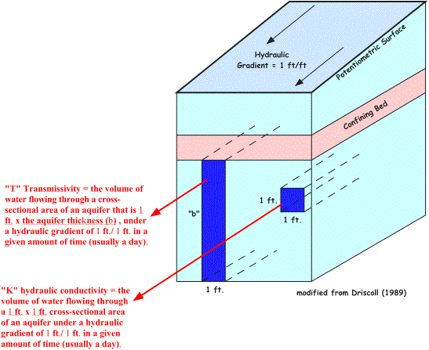
Hydraulic conductivity-Transmmissivity
Source: http://www.waterrights.utah.gov/wellinfo/theis/hydrogeology_discussion.asp

Slide 20
Groundwater flow-Darcy’s law
The Darcy Law of regarding groundwater flow through a soil material is given by the following equation:
Q= k × i × A
where:
Q= discharge (m³/s)
K= hydrailic conductivity (m/s)
i=hydrailic gradient
A= surface of soil mass perpendicular to the waqter flow direction (m²)
Q/A=v
v= groundwater velocity (m/s)
v= k × i
Darcy’s law takes into account the following assumptions:
The soil is saturated
The flow through soil is laminar
The flow is continuous and steady
The total cross sectional area of soil mass is considered

Slide 21
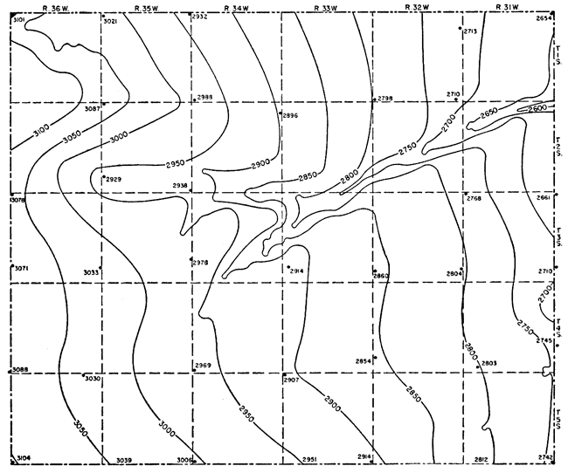
Groundwater flow-Groundwater level
The level of the upper surface of the zone of saturation is depicted in maps called «Water table maps». The groundwater level is expressed as elevation (above sea level). The water table contours that join groundwater points that have equal head (elevation) are usually called «Equipotential lines».
Source: http://www.kgs.ku.edu/General/Geology/Rawlins/05_gw.html

Slide 22
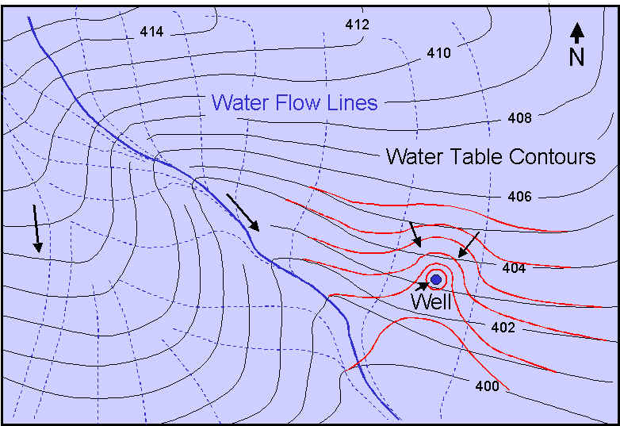
Groundwater flow-Groundwater flow lines
Groundwater always moves from an area of higher hydraulic head to an area of lower hydraulic head. In an isotropic aquifer groundwater moves perpendicular to equipotential lines. Therefore the groundwater flow direction can be traced and depicted on a map, by drawing flow lines following the aforemtnioned guidelines.
The red lines depict the water table contours during a well pumping
Source: http://geology.isu.edu/wapi/EnvGeo/aquifer_gw_review/flownets.htm

Slide 23
Determination of Hydraulic Conductivity
Hydraulic conductivity can be determined by different type of methods. There are methods conducted in the field, in the laboraroty and methods which are indirect. These methods are subdivided to the following categories:
Laboratory test
Constant head test
Falling head test
Field methods
Pumping out test
Pumping in test
Indirect methods
Computation from the particle sieze
Computation from consolidation test
In the following slides indicative methods of hydraulic conductivity determination used in hydrogeology are presented

Slide 24
Determination of Hydraulic Conductivity
LABORATORY METHODS
Estimation from grain size:
k= C×(d₁₀)²
C=Hazen's empirical coefficient, which takes a value between 0.0 and 1.5 with d in mm and k in cm/s
D₁₀= is the diameter of the 10 percentile grain size of the material

Slide 25
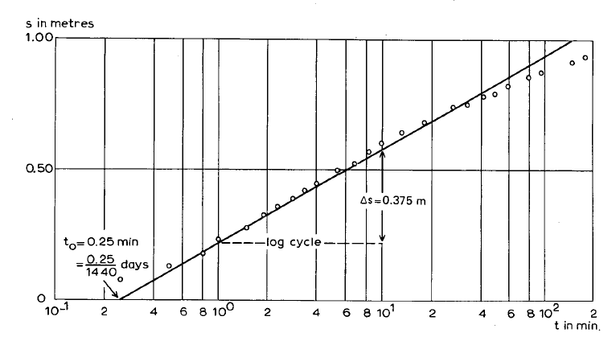
Determination of Hydraulic Conductivity
FIELD METHODS
Jacob method (δ-logt)
Διάγραμμα πτώσης στάθμης-log χρόνου.
A well is pumped with constant dicharge. The water level drawdown versus time is depicted on semi-logarithmic diagramm. The hydraulic conductivity is estimated by the following equations

